Slide 1
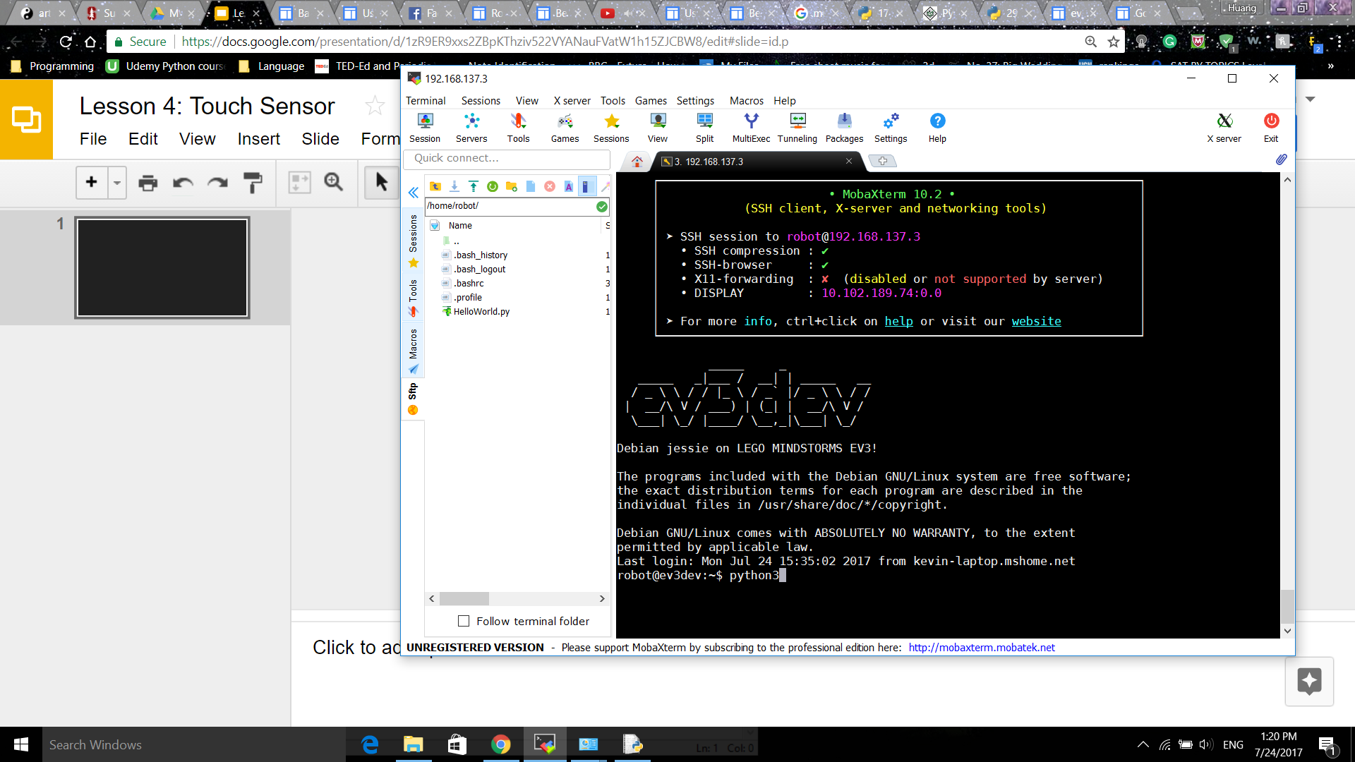
In the command prompt, type python3

Slide 2
dir and help
+In Python3 interactive mode, after importing the ev3dev.ev3, you can see what module EV3 contain and what attributes each module has using dir.
>> dir(‘module’)
+Type help(‘module’.<attribute>) for more details.
‘module’.<attribute>[.attribute] ( square brackets mean optional)
>> help(‘module’.<attribute>)

Slide 3
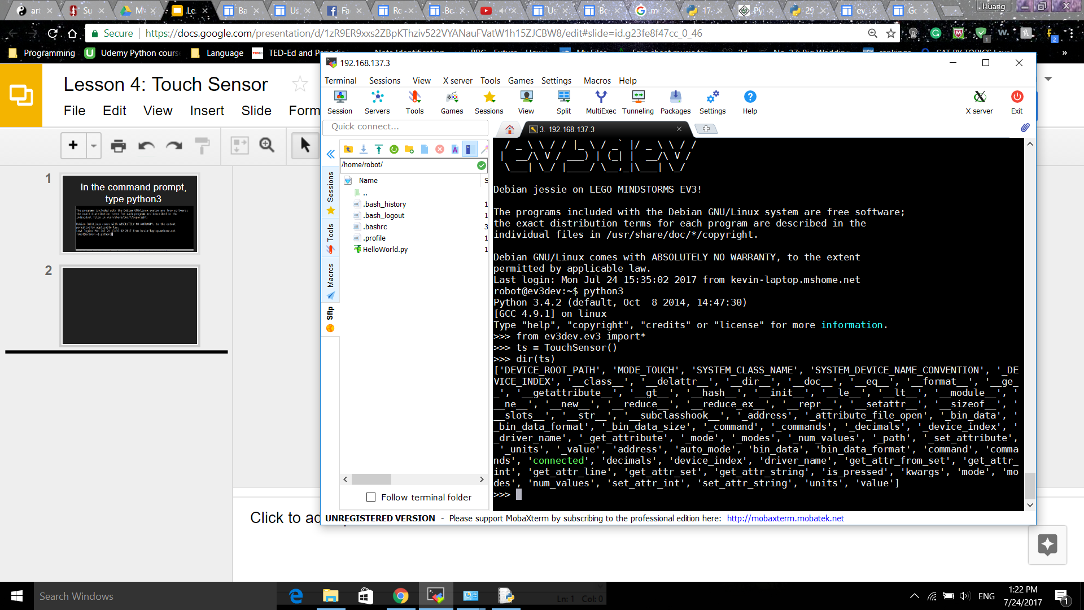

Slide 4
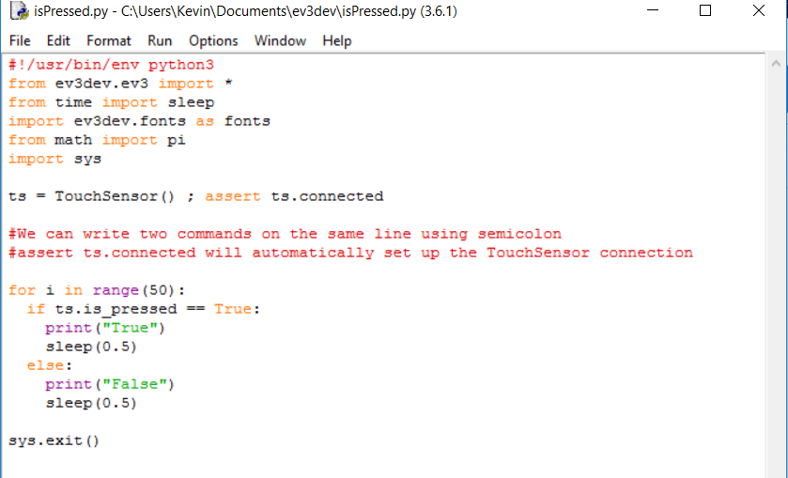
Example Code 1 using is_pressed attribute

Slide 5
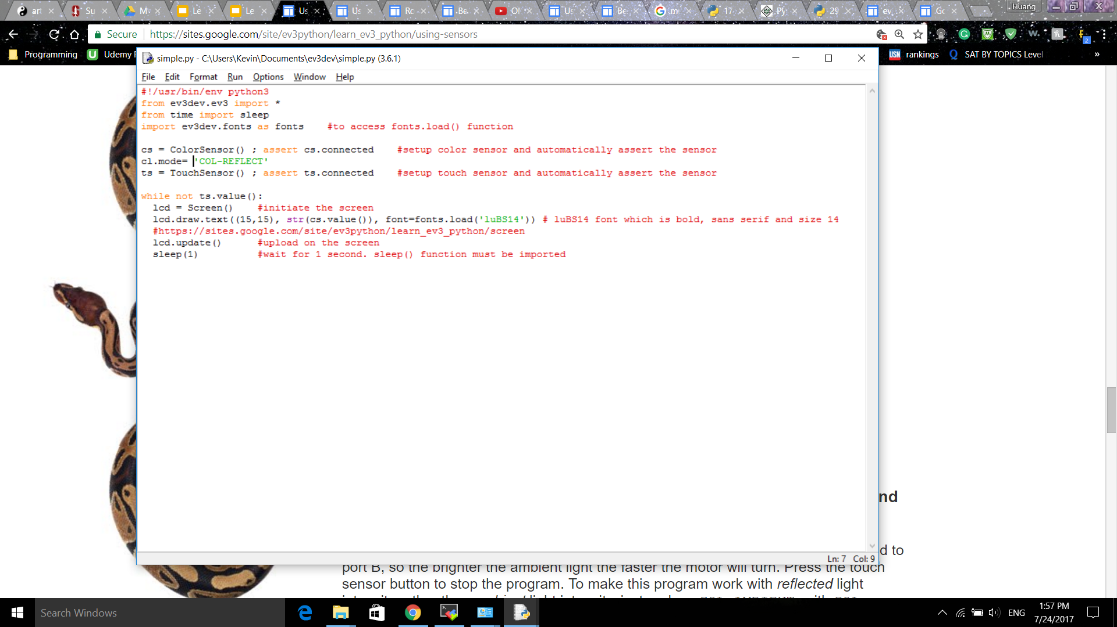
Example 2: Printing Color Sensor value

Slide 6
Exercise 1:
Step 1: RUN THIS PROGRAM IN COMMAND LINE only! Create a variable that will store the number of presses from the Touch Sensor. Then print it out on the BRICK’s screen using Screen() function. Remember to use str() function to convert the variable from integer type to string type.
PRESS CTR+C to exit the program.

